Slide 1



MALWARE ANALYSIS AND PREVENTION STRATEGY PROJECT

Slide 2

Agenda
MALWARE
SIEM
PREVENTION STRATEGY
Analyze different types of malware, develop a prevention strategy, and implement SIEM for monitoring

Slide 3

MALWARE
Protect Yourself

Slide 4
Agenda
01
What’s the Malware?
02
Types of Malware and Their Impact
03
Malware Analysis

Slide 5
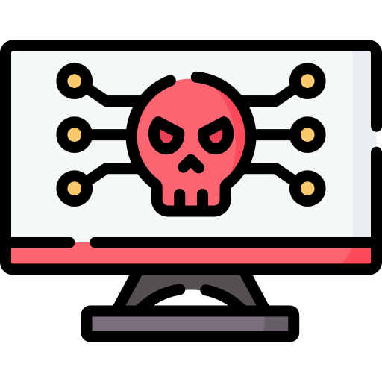
What is a Malware?
Malware (malicious software) refers to any software intentionally designed to cause damage, exploit, or infiltrate systems, networks, and devices.

Slide 6
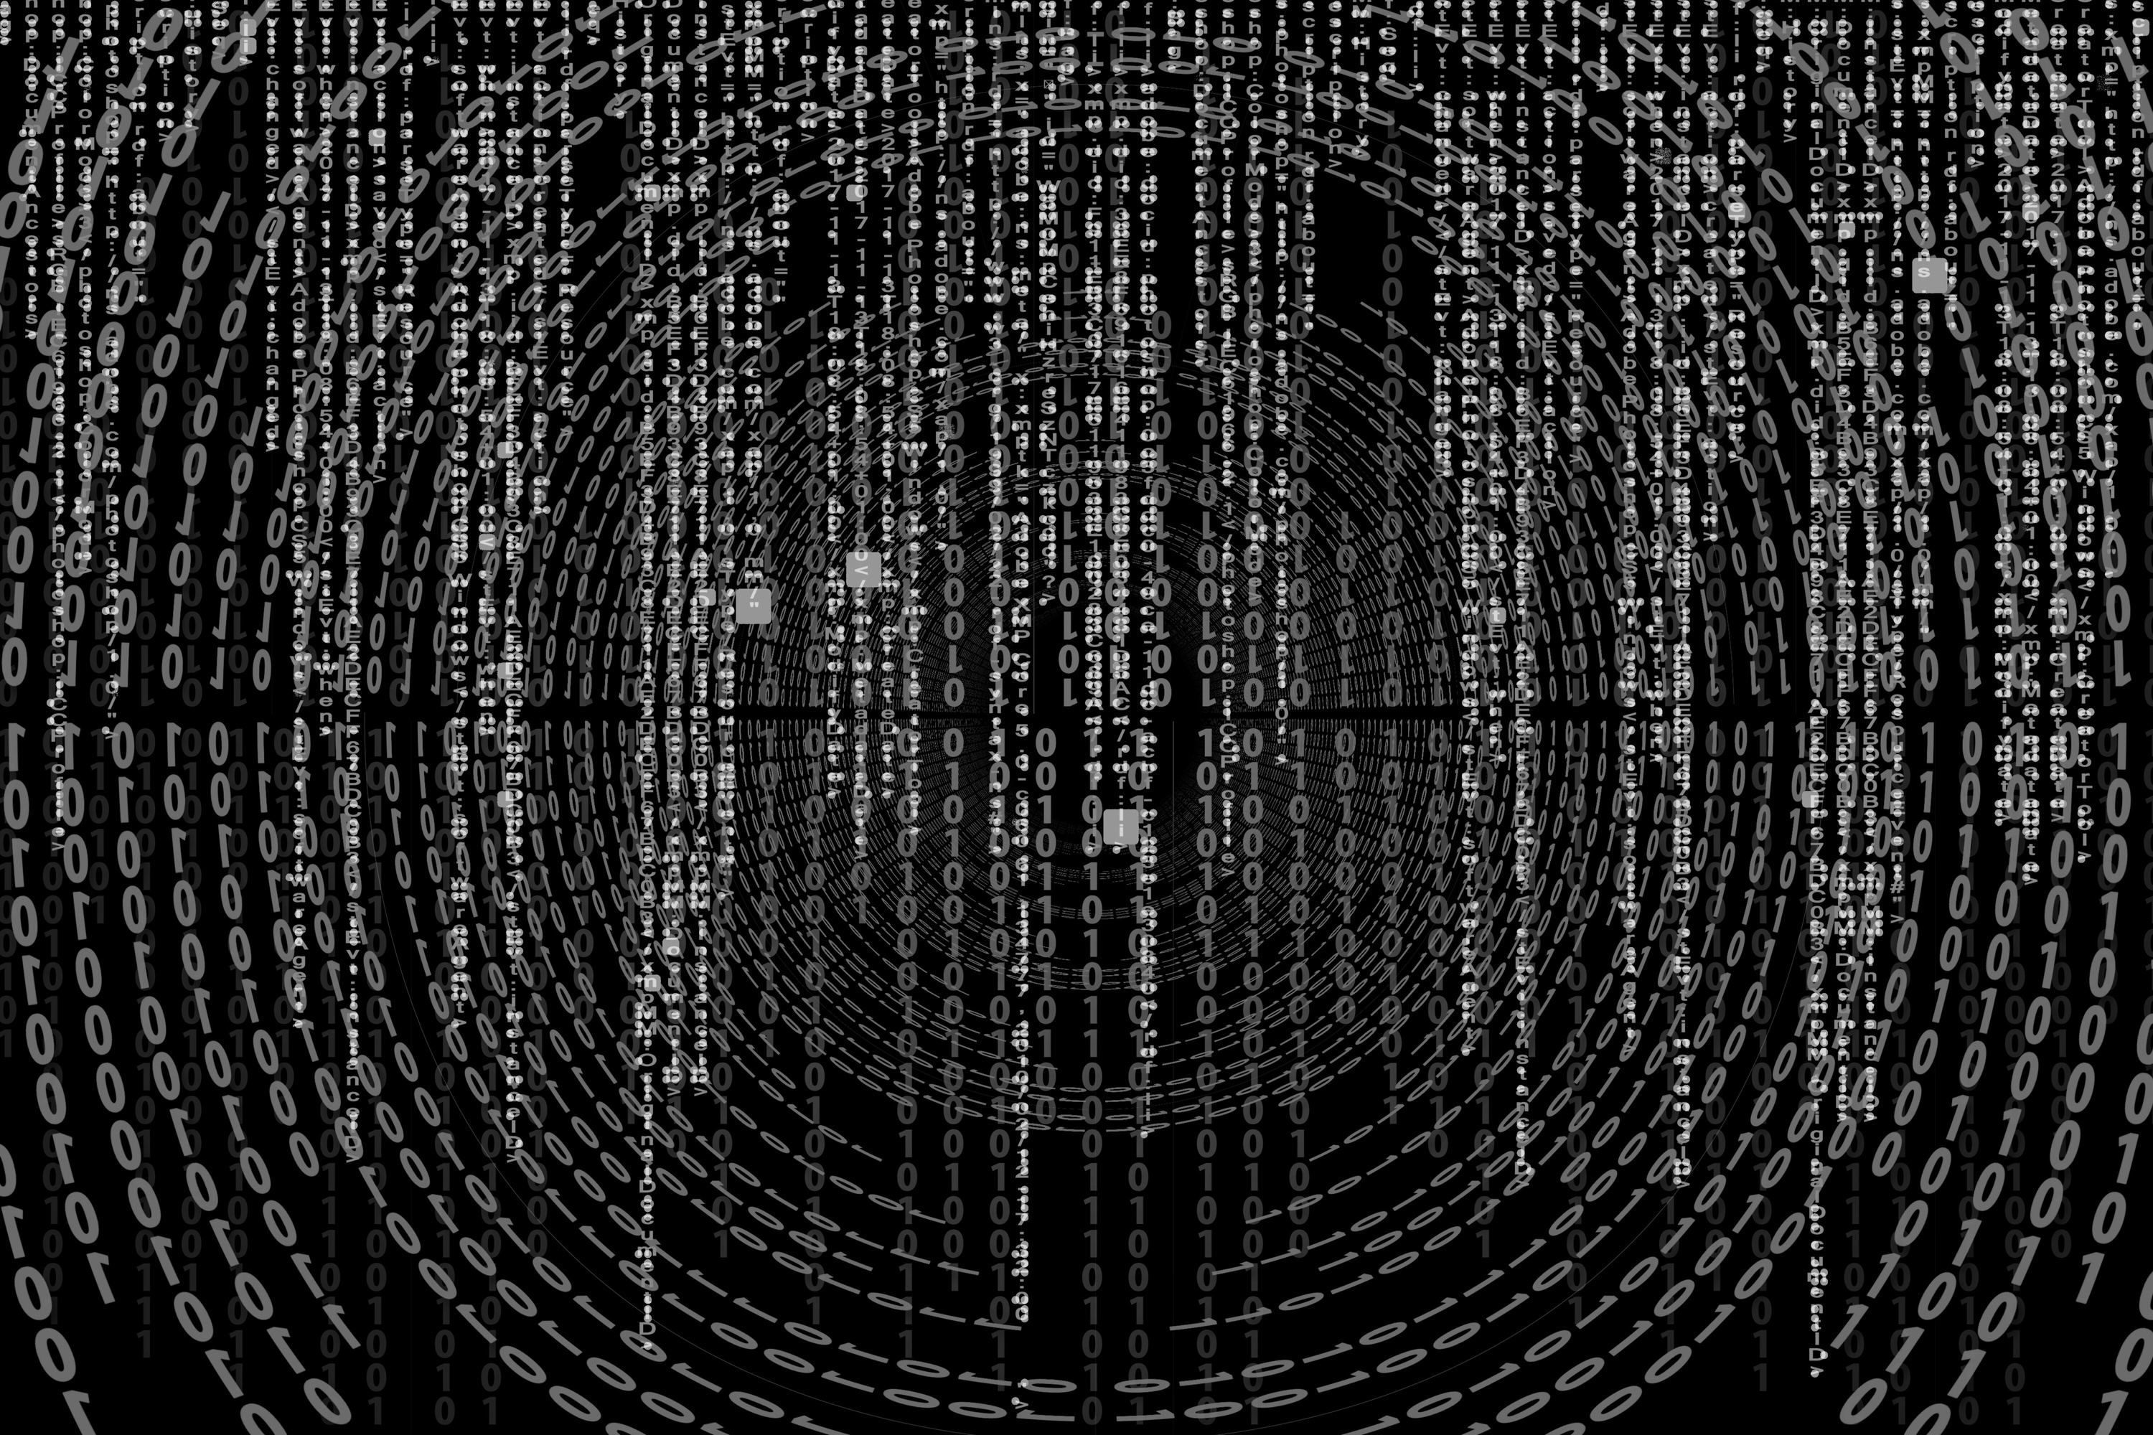

MALWARE TYPES
Viruses
Worms
Trojans
Ransomware
Rootkits
Adware
Spyware
Backdoors
Keyloggers
Fileless Malware
Phishing
(Social Engineering)
Botnets

Slide 7



VIRUS
Self-replicating malware that attaches itself to legitimate files or programs. Once executed, it spreads to other files and systems.
Can corrupt or delete data
Causes system crashes

Slide 8



Worms
Similar to viruses, but worms do not need human interaction to spread. They replicate themselves and propagate across networks independently.
Consumes system resources and bandwidth
Used to deploy other malicious payloads

Slide 9



Trojans
Malicious software disguised as legitimate software or files. Users are tricked into installing them, which grants unauthorized access or control.
Steals sensitive information
May spread other types of malware

Slide 10
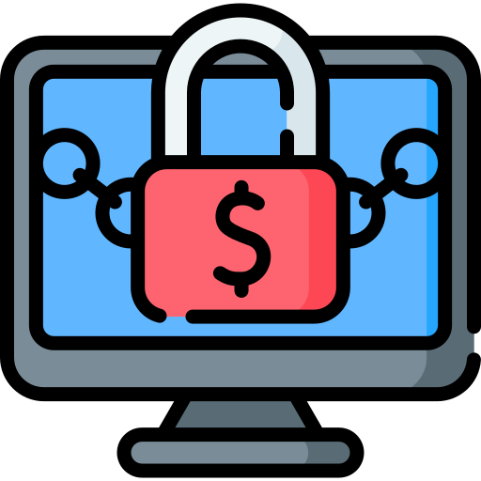


Ransomware
Malware that encrypts a victim's data and demands a ransom payment to restore access.
Data loss or financial extortion
Disruption of businesses, hospitals, or government services

Slide 11
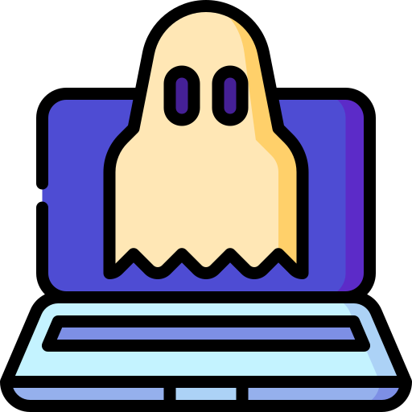


Rootkits
Software that provides unauthorized access to a system by hiding in the background.
Can hide the presence of other malware
Gives attackers control over infected systems

Slide 12
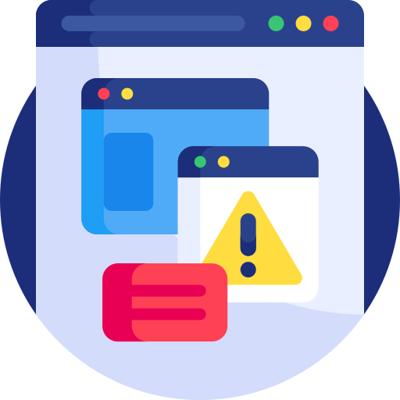

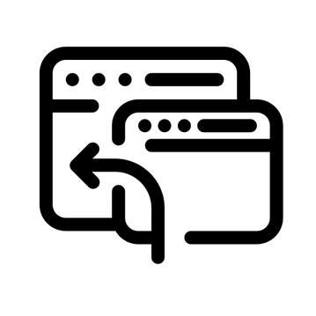
Adware
Software that automatically displays or downloads advertisements to a user's system.
Can redirect users to malicious websites
May gather personal data without consent

Slide 13
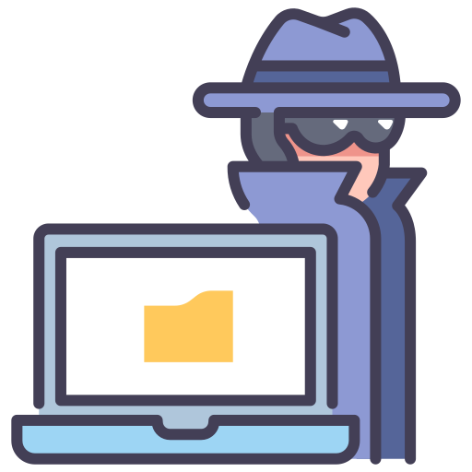
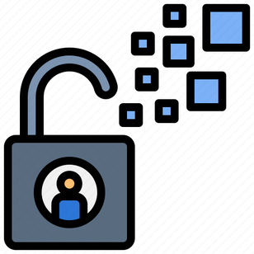
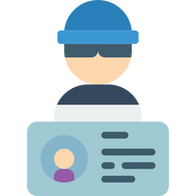
Spyware
Malware that secretly monitors user activity and collects information such as browsing habits and sensitive personal data
Compromises Privacy
May lead to identity theft

Slide 14



Backdoors
Hidden methods of bypassing normal authentication to gain unauthorized access to a system.
Allows hackers to control systems remotely
Leaves systems vulnerable to future attacks

Slide 15
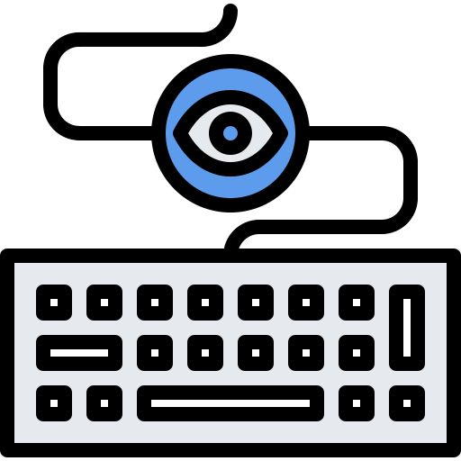
Keyloggers
Malware that records every keystroke made by a user, capturing passwords, credit card numbers, and other sensitive information.
Theft of personal and financial data

Slide 16
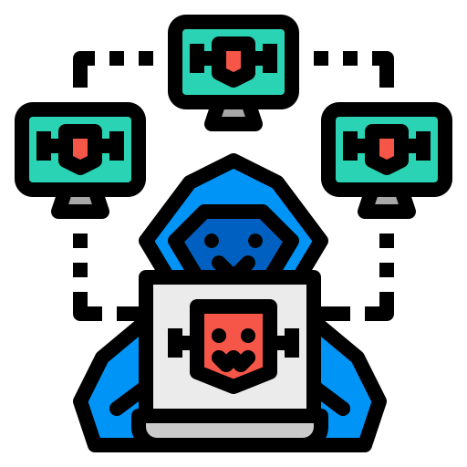
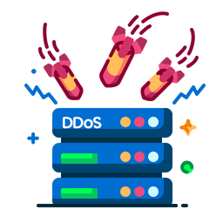
Botnets
A network of compromised devices (bots) controlled by a single attacker or group. Botnets are often used for large-scale attacks like Distributed Denial of Service (DDoS) attacks.
Used to send spam, steal data, or launch attacks

Slide 17
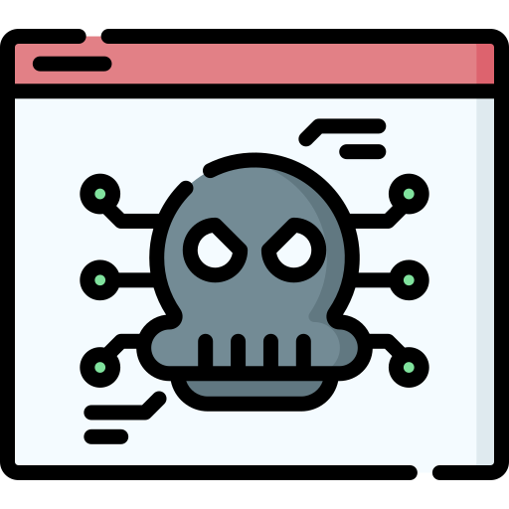

Fileless Malware
Malware that operates in memory, rather than being installed on disk. It exploits legitimate software and processes, making it harder to detect.
Can cause significant damage before detection
Difficult to trace and remove

Slide 18


Phishing
Not technically malware, but phishing is a form of social engineering attack that tricks users into revealing sensitive information
Often the entry point for other malware
Leads to data breaches and financial loss

Slide 19
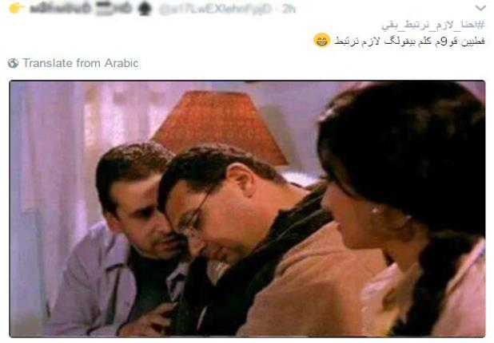
The Importance of Protection
اصحى ليغفلونا
Malware comes in various forms, each with unique attacks
To prevent it, use strong antivirus software, keep systems updated
Vigilance is key for both companies and individuals.
01
02
03
Think Before You Click!

Slide 20

MALWARE
ANALYSIS
Let’s understand the enemy

Slide 21

What’s the Malware Analysis
The process of studying malware to understand its origin, functionality, and impact. It helps security professionals identify how malware works and develop countermeasures.
Contact IT support or technical assistance.
Static Analysis
Dynamic Analysis

Slide 22
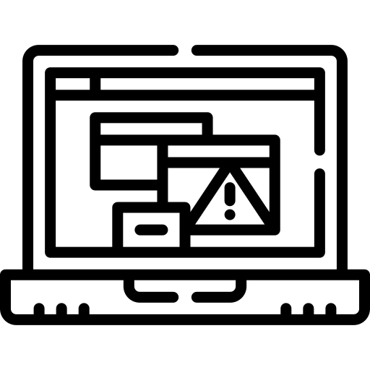


Malware Analysis
Adware
Ransomware
Contact IT support or technical assistance.
Trojan

Slide 23
Adware

Slide 24

Adware
Rhadamanthys Adware
Rhadamanthys is an advanced information stealer, first identified in 2022, and designed to steal sensitive information by disguising it as fake Notepad++ installers using Google Ads.

Slide 25
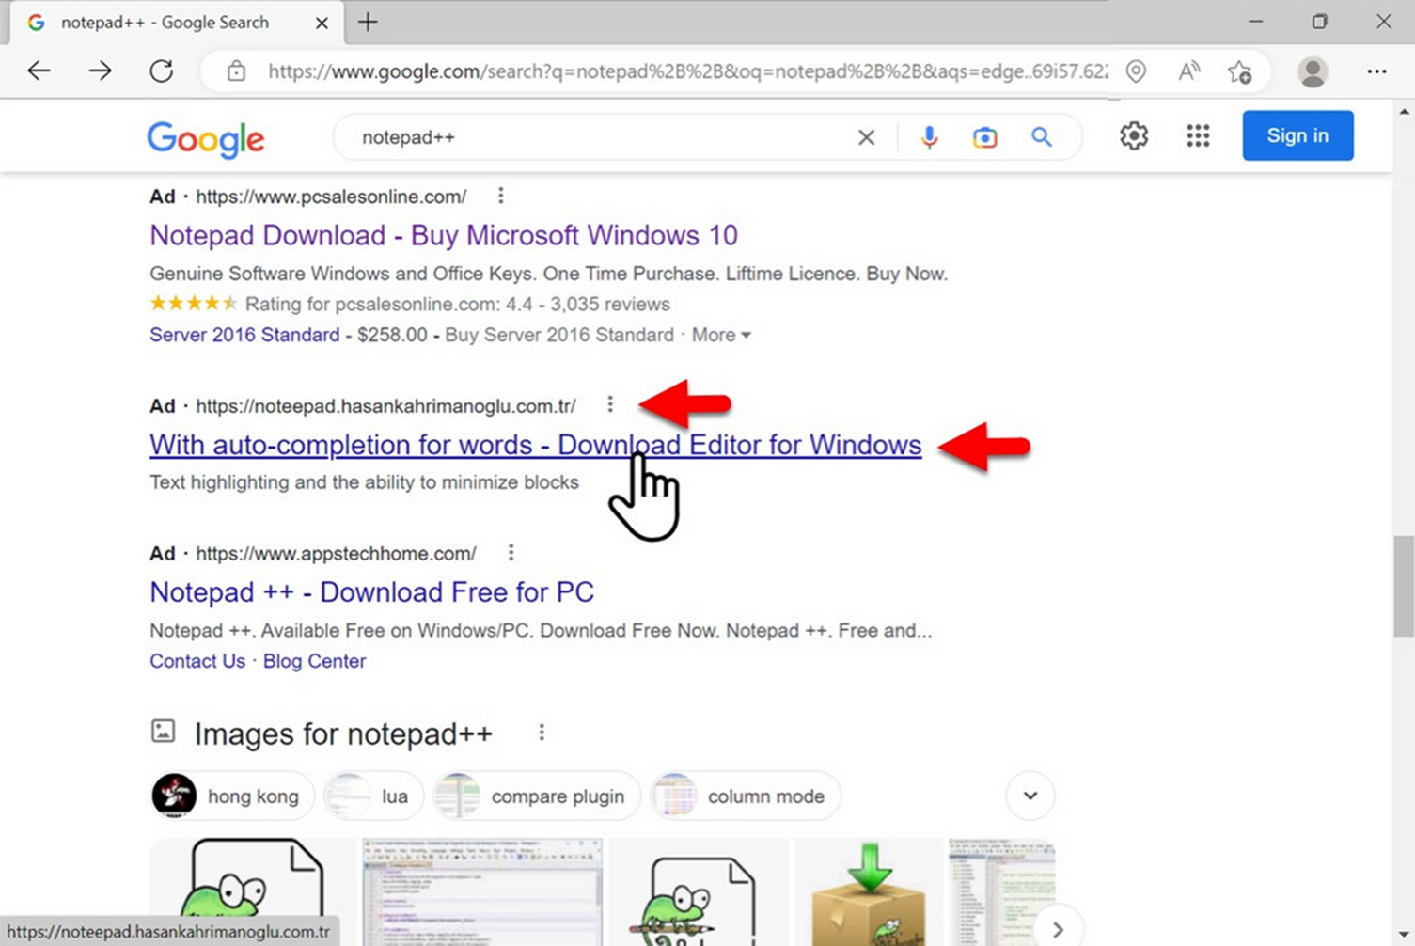
GOOGLE AD LEADING TO FAKE NOTEPAD++ SITE

Slide 26
Adware
Static Analysis

Slide 27
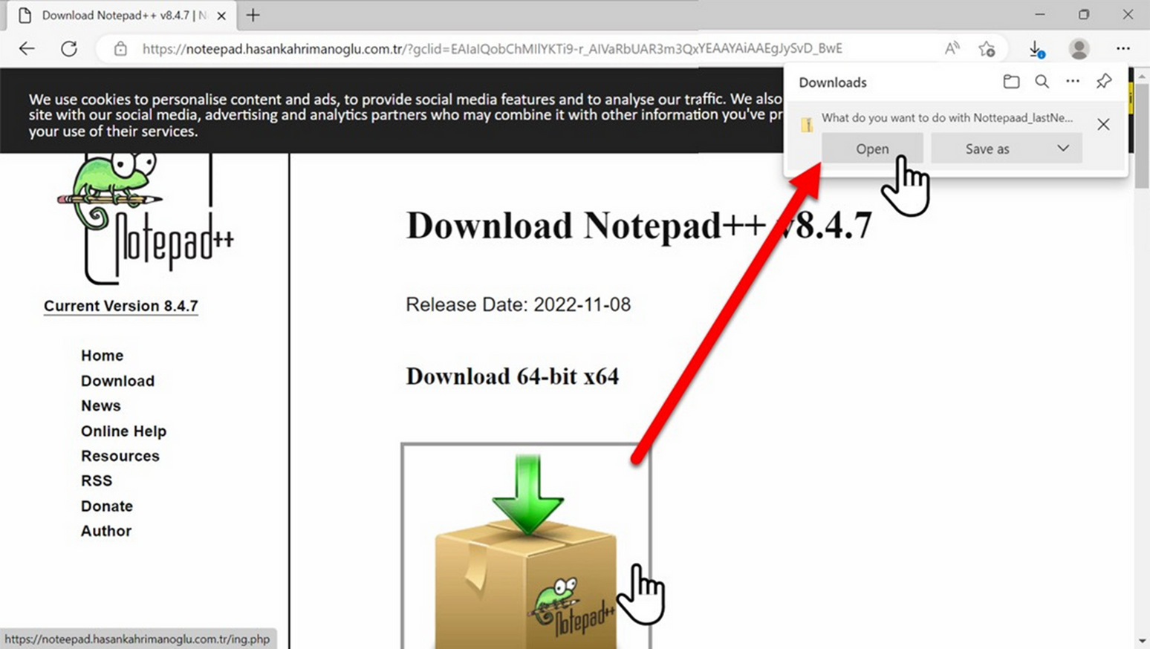
DOWNLOADING ZIP ARCHIVE FROM FAKE NOTEPAD++ PAGE

Slide 28
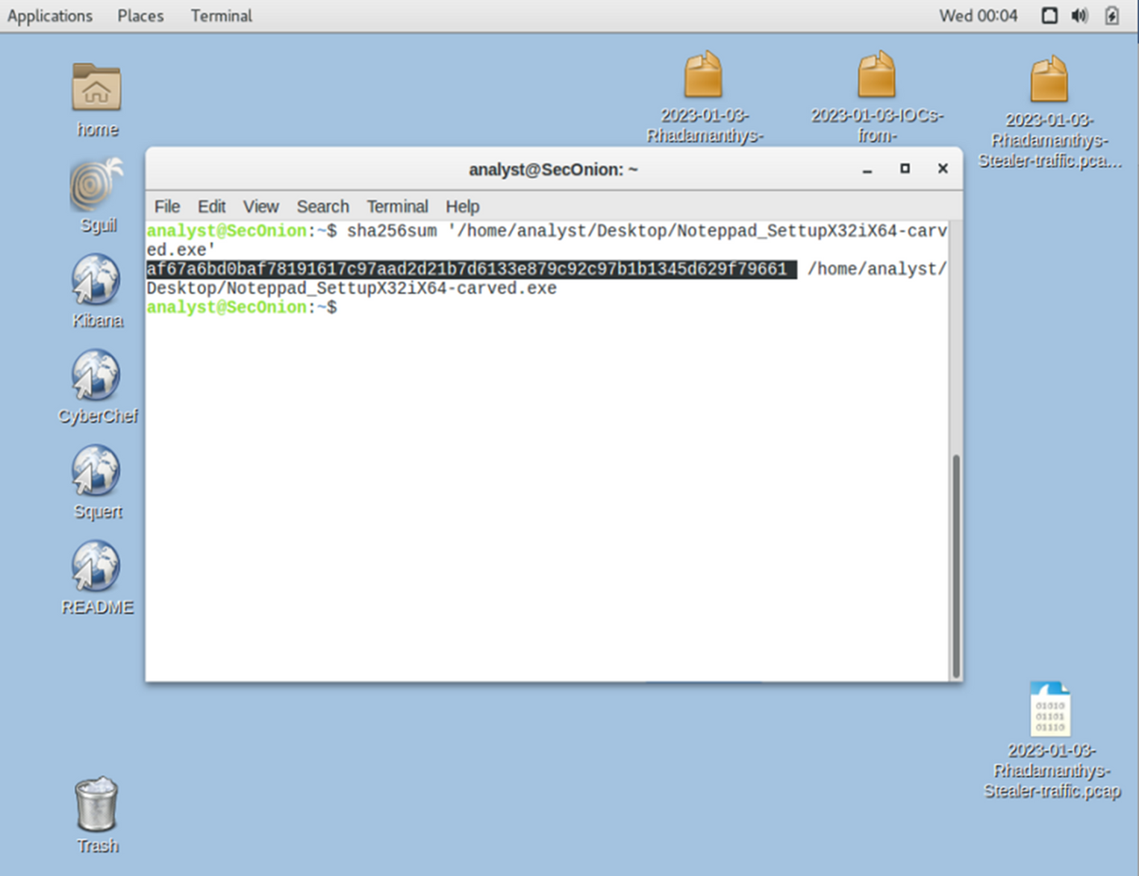
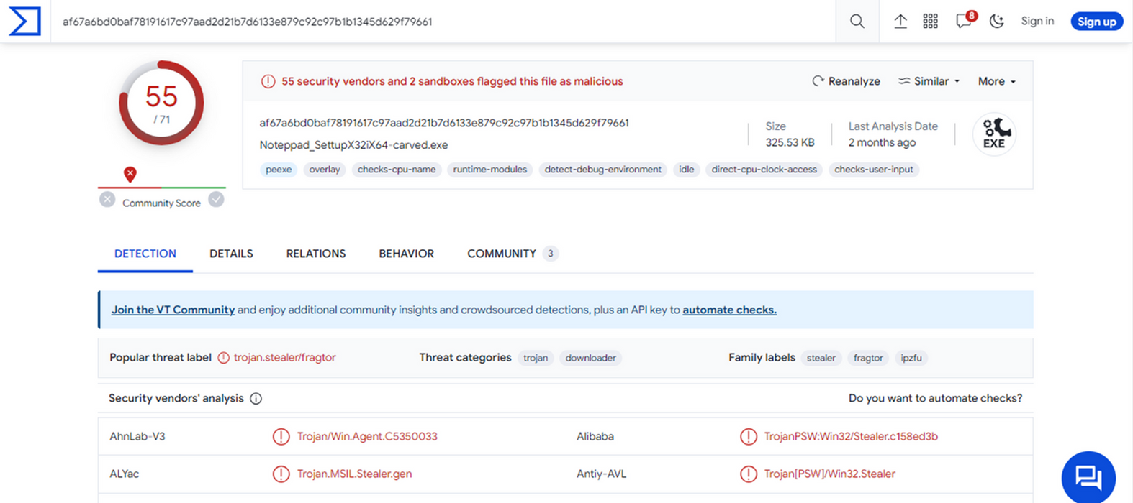
Check For the File HASH ON VIRUSTOTAL

Slide 29
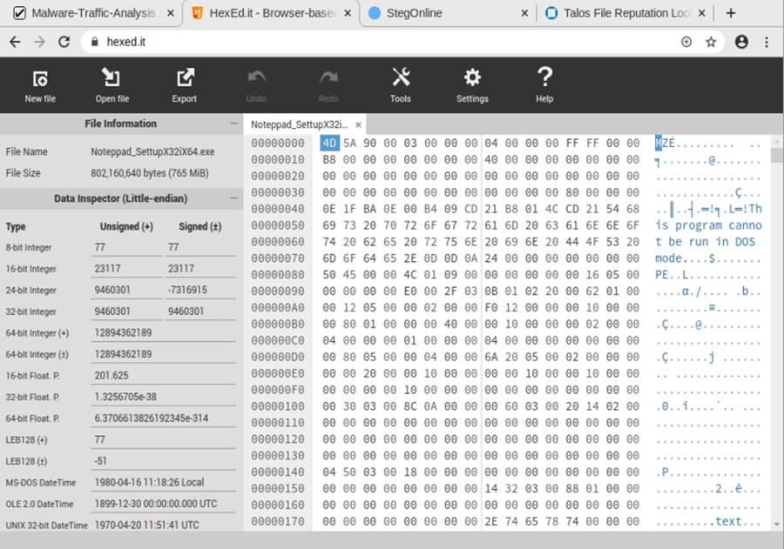

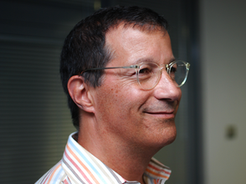
File Hex Data Analysis
Used Hexit as Hex Editor for file analysis
MZ header (4D 5A)
OR
PE Header
"Portable Executable"
(50 45)

Slide 30
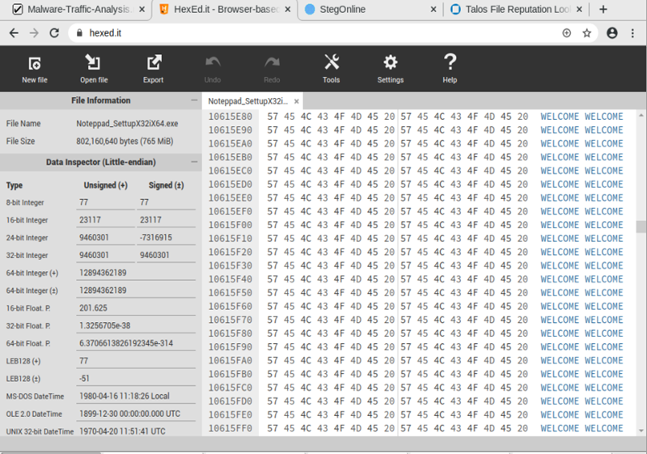
File Hex Data Analysis
Padding
padding refers to the practice of adding extra, non-functional data to a file or code to alter its size or structure without affecting its functionality.
Obfuscation and Evasion
Defeating Signature-Based Detection
Anti-Reverse Engineering
File Alignment

Slide 31
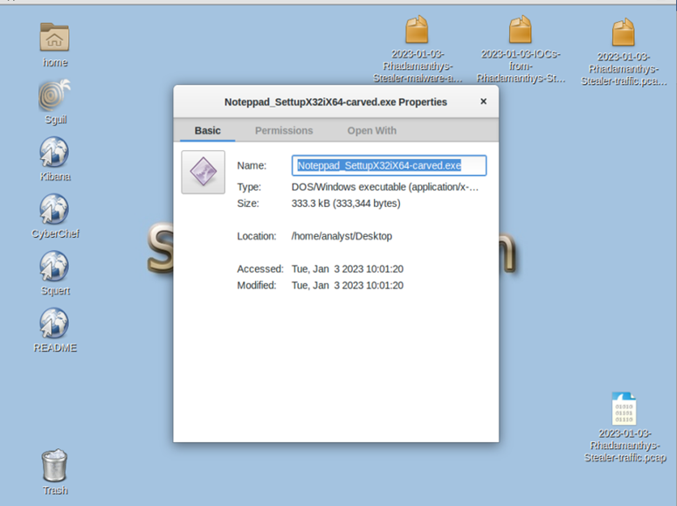
File Hex Data Analysis
After removing all the garbage strings the file size been reduced from 802 mb to 333 kb

Slide 32
Adware
Dynamic Analysis

Slide 33
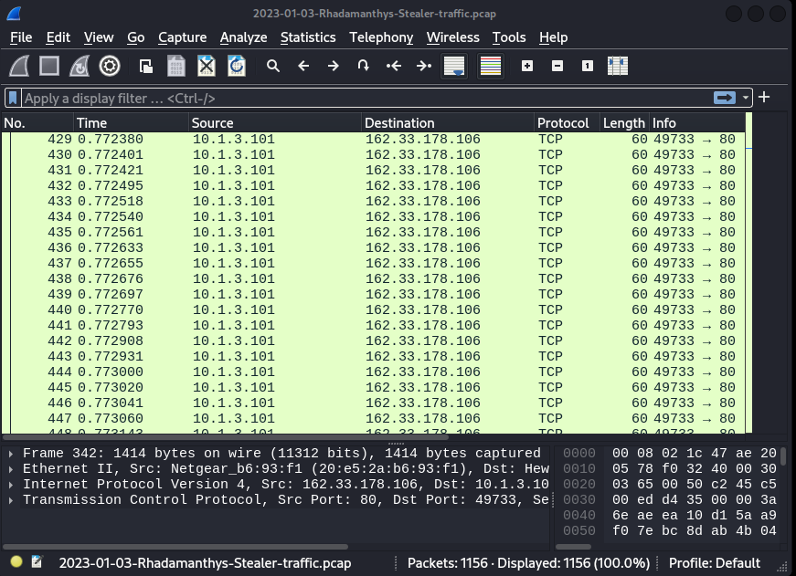
Traffic Analysis
Lets capture the Malware Behavior

Slide 34
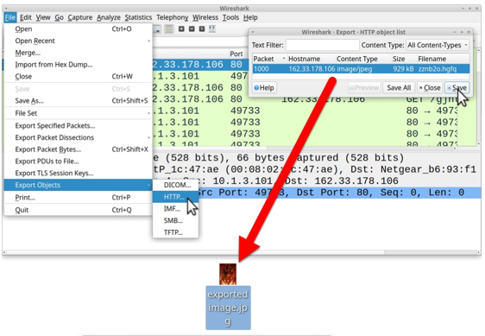
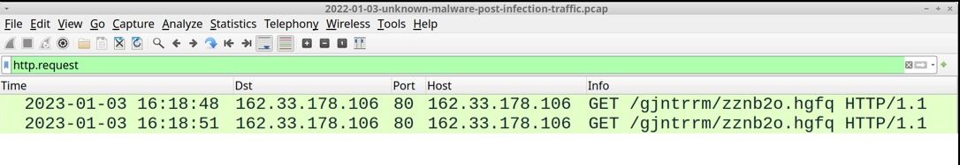
Traffic Analysis
exe file redirect to HTTP GET request from our host to HTTP server “162.33.178.106/80” that returns a 929,566 byte .jpg image
Steganography
is the practice of concealing information within another message or physical object to avoid detection.

Slide 35
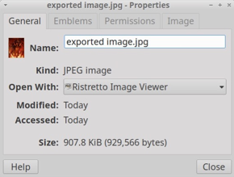
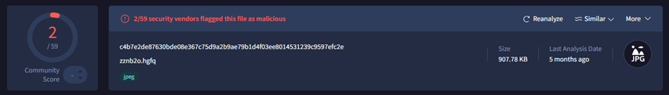
Steganography
the malware initiates several GET requests, followed by encrypted websocket traffic for data exfiltration.

Slide 36
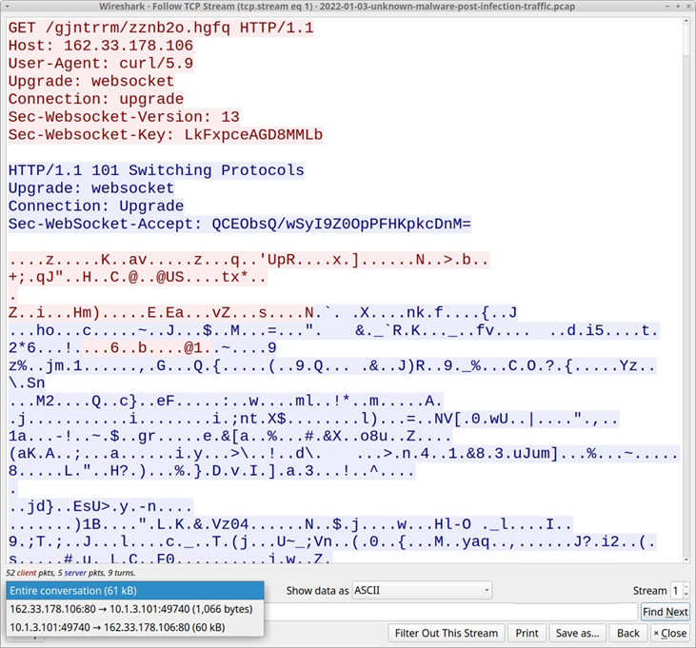
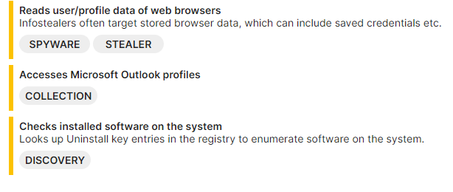
WebSocket Traffic
A switch to encrypted websocket traffic for exfiltration, indicating an advanced effort to evade detection during and after the infection.

Slide 37
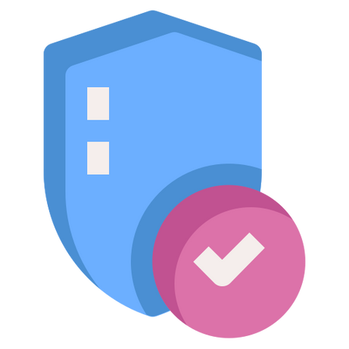
Artifacts
Fake Notepad++ Site: hxxps[:]//noteepad.hasankahrimanoglu[.]com[.]tr/
Malicious ZIP Download URL: hxxps[:]//noteepad.hasankahrimanoglu[.]com[.]tr/ing.php
Padded EXE:
SHA256 hash: 8d0e8bafffed28f5c709a99392f7ab42430635839f7aba92a01c956c10702c8f
Size: 802 MB
Carved EXE:
SHA256 hash: af67a6bd0baf78191617c97aad2d21b7d6133e879c92c97b1b1345d629f79661
Size: 333 KB
Steganography Image:
SHA256 hash: c4b7e2de87630bde08e367c75d9a2b9ae79b1d4f03ee8014531239c9597efc2e
C2 Server:
IP Address: 162.33.178[.]106
Port: 80

Slide 38
Ransomware

Slide 39
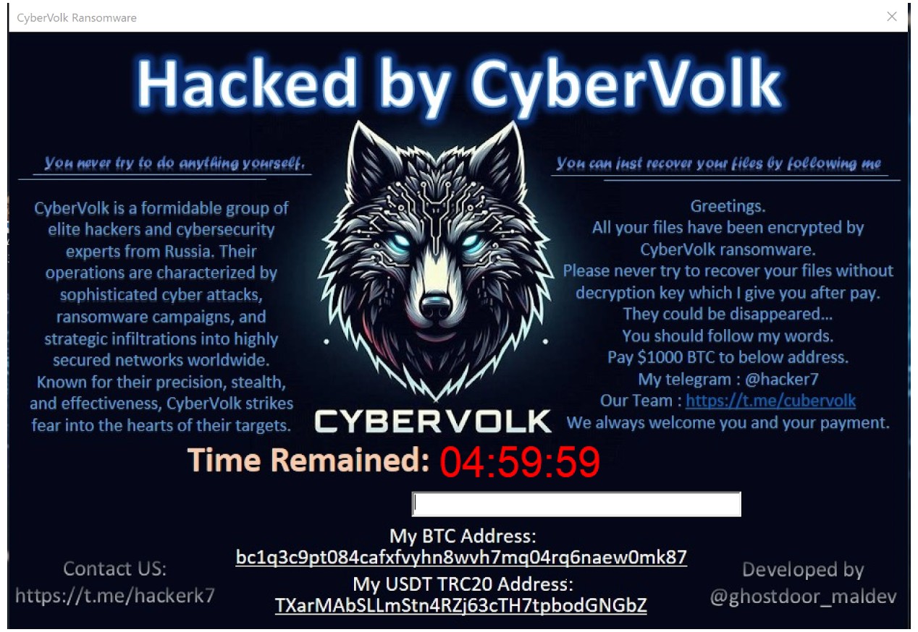
Ransomware
CyberVolk Ransomware
CyberVolk emerged in June 2024 as a hacktivist group associated with pro-Russian activities.

Slide 40
Cybervolk Ransomware
CyberVolk Ransomware was first completed on July 1, 2024, and it was detected
being marketed as RaaS (Ransomware as a Service) on the dark web and Telegram
on July 3, 2024. The initial ransomware was developed in the C++ language and,
like most ransomware, uses the AES encryption algorithm. The SHA512 hash
algorithm is used for AES key generation

Slide 41
Ransomware
Static Analysis

Slide 42
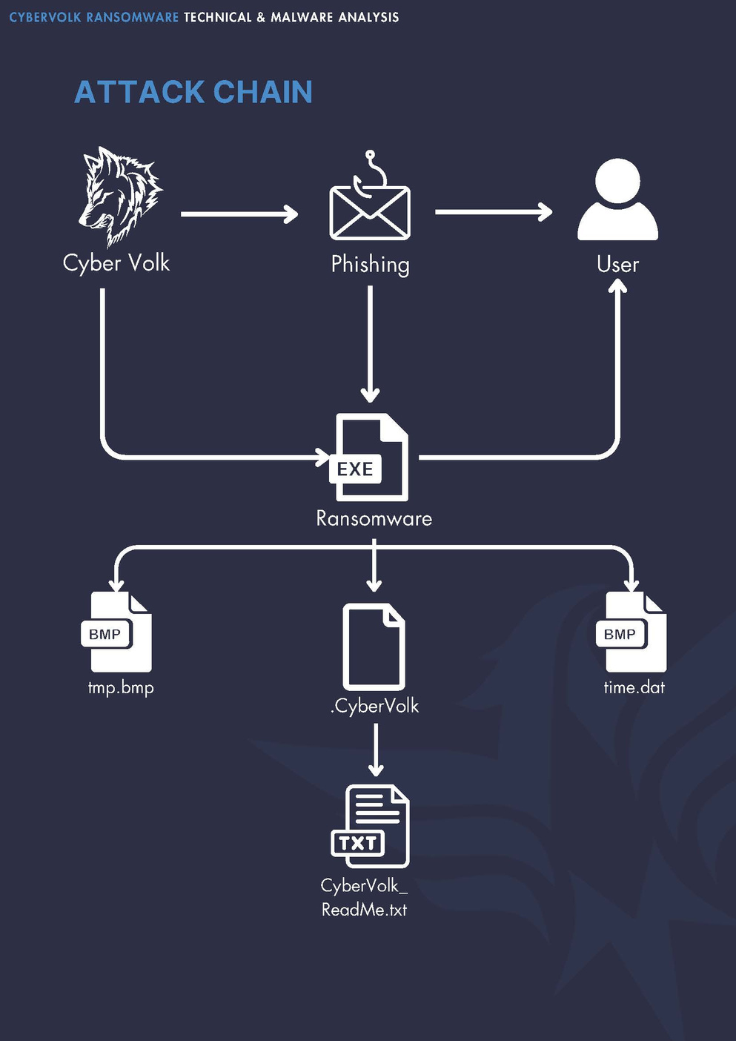
Attack Chain

Slide 43
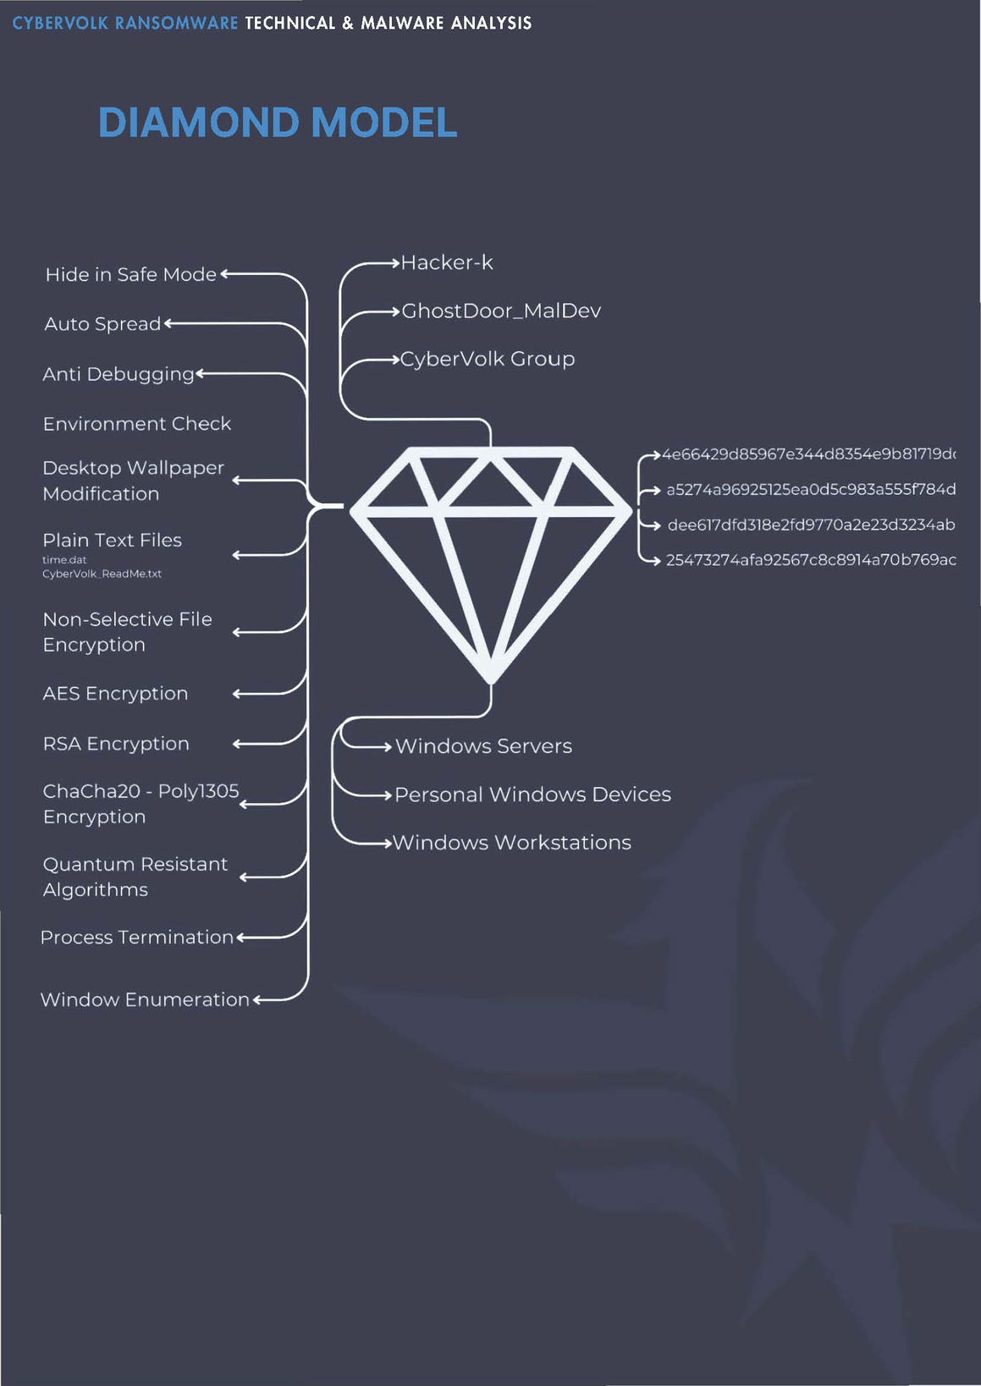
Diamond Model

Slide 44
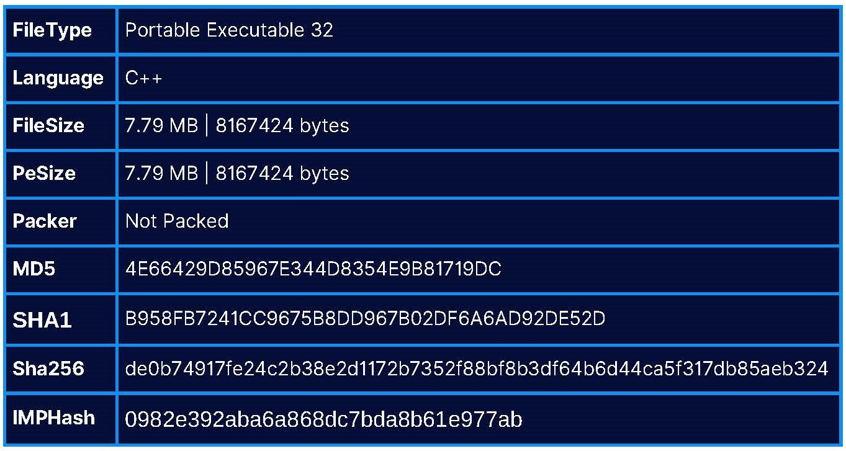
Basic Characteristics

Slide 45
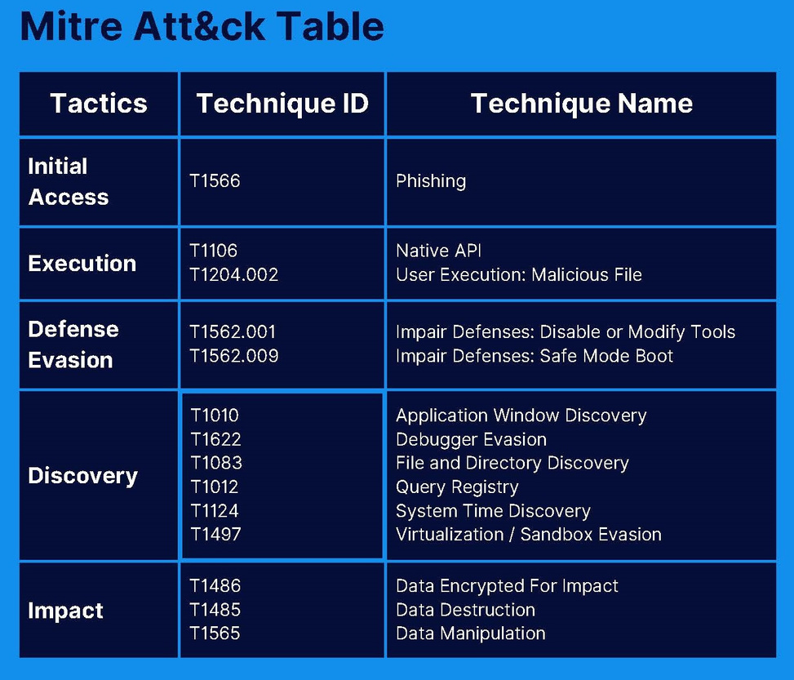
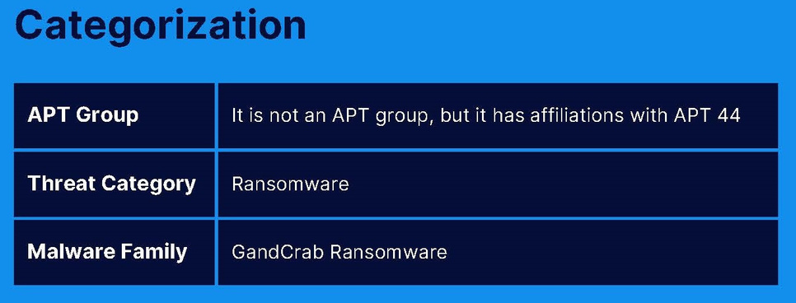
Malware Analysis

Slide 46
Ransomware
Dynamic Analysis

Slide 47
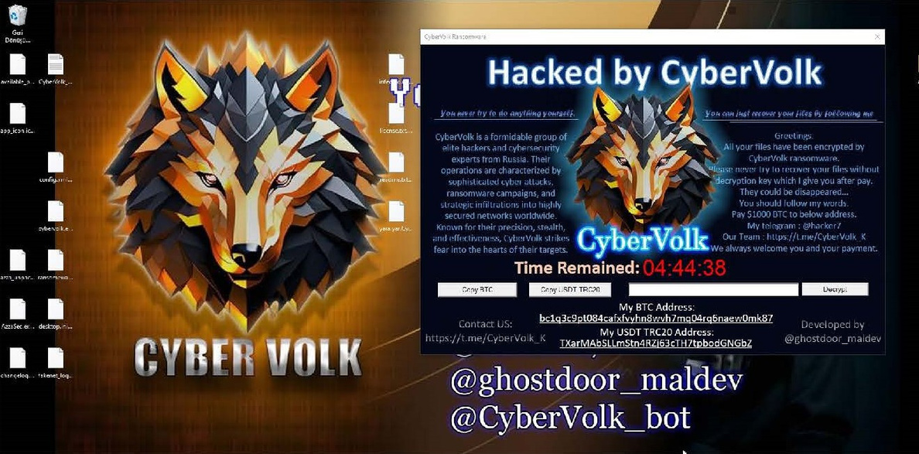
Execution Phases
Your paragraph text
Writes BMP file to $HOME\AppData\Temp directory and sets as background.
Creates time.dat file with a 5-hour timer.
Encrypts files in $HOME directory, deletes unencrypted files.
BMP Creation
Timer Setup
Encryption Process

Slide 48
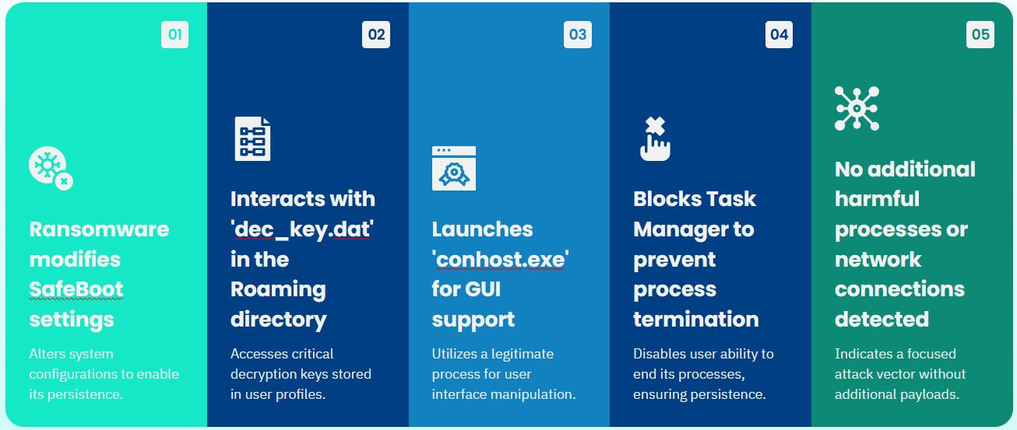
Behavioral Analysis

Slide 49
Encryption
After creating the time.dat file, it starts encryption from the first directory of
the $HOME directory.
Firstly, it creates a file with .CyberVolk extension and then encrypts it by reading the contents of the file, then writes the encrypted data into the file with .CyberVolk extension.
Then it deletes the unencrypted file from the system.

Slide 50
Identified Vulnerabilities
PowerShell Process Termination
The ransomware can be terminated using PowerShell commands, indicating a potential point of intervention.
Lack of Persistence
The ransomware does not maintain its re-encryption capabilities after a system restart, limiting its long-term impact.
Modification of Countdown
Altering 'time.dat' allows users to extend the ransomware countdown, providing additional time for recovery efforts.

Slide 51
Trojan

Slide 52

Trojan
Emotet Malware
MUMMY SPIDER is a criminal entity linked to the core development of the malware most commonly known as Emotet or Geodo. First observed in mid-2014, this malware shared code with the Bugat (aka Feodo) banking Trojan.

Slide 53
Characteristics of Emotet
MITRE ATT&CK ID: S0367
Role in Cybercrime: Core of a vast cybercriminal network
Delivery Methods:
Phishing emails (common)
Vulnerabilities and brute force attacks
Botnet: Infrastructure-as-a-Service (IaaS)
Capabilities:
Infection, persistence, lateral movement
Data exfiltration (traffic capture, credential theft)
Dropping additional malware like TrickBot, Qbot, and ransomware (Ryuk, Bitpaymer)

Slide 54
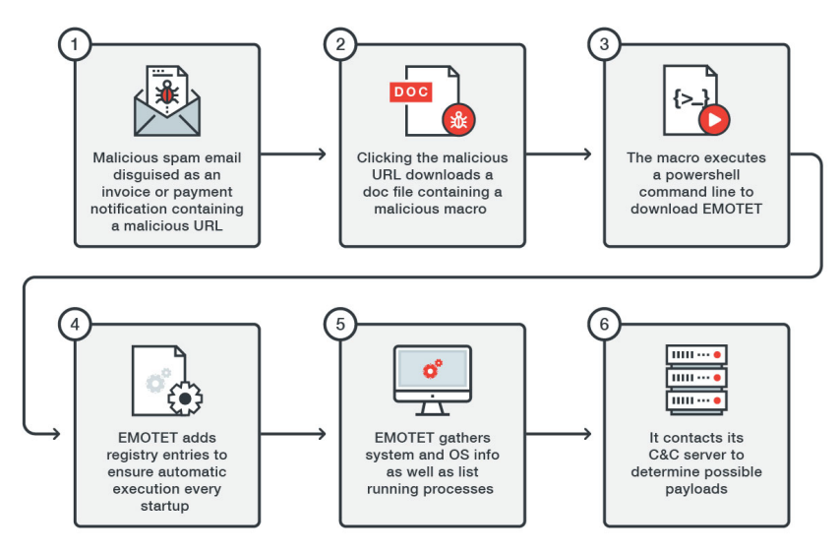
Functionality of Emotet

Slide 55
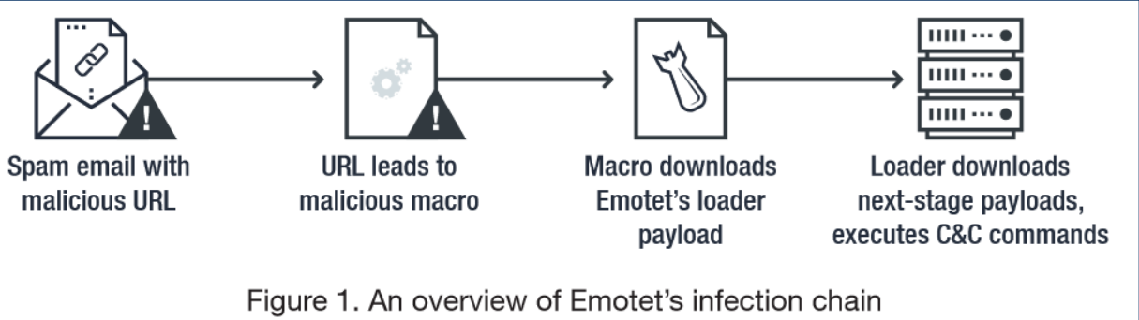
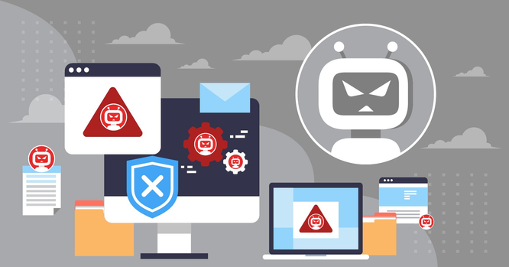
Initial Access
Emotet follows a simple and common chain of steps for initial infection:
Emotet as First Stage:
Dropping Malware: Often drops malware like TrickBot, which further escalates the attack.

Slide 56
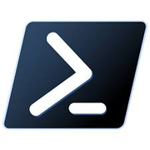

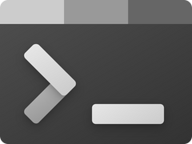
Execution Methods
PowerShell
Visual Basic
Windows Command Shell

Slide 57
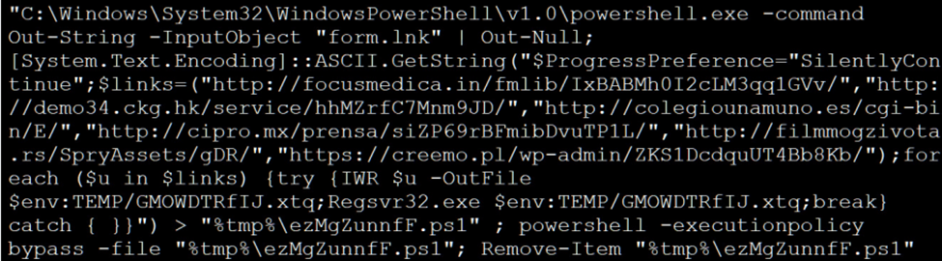
PowerShell
Emotet can leverage PowerShell to download the payload and install itself.
Below is the code to download Emotet and save it to the %Temp% folder, and then execute it with the regsvr32.exe command.

Slide 58
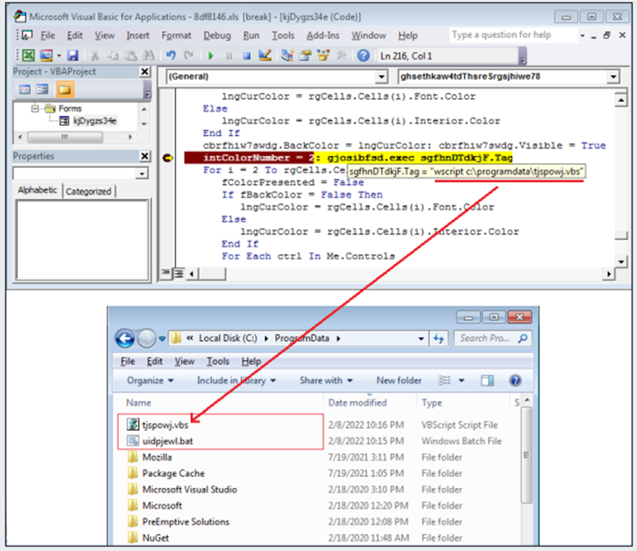
Visual Basic
Emotet has been known to use Visual Basic (.vbs) files to execute its payload.
Emotet has moved away from this tactic after Microsoft disabled macros from the Internet by default earlier in 2023.
Visual Basic file embedded in a malicious macro.

Slide 59
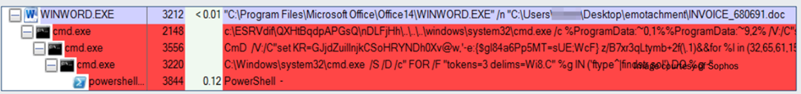
Windows Command Shell
Emotet also uses Windows Command Shell for execution.
Process Explorer below depicts three steps:
1. The first command (cmd.exe) uses bogus directory paths until it navigates back to the root directory, down the correct path to invoke cmd.exe again.
2. The second command decodes part of the obfuscation and then executes the third command (cmd.exe).
3. The third command launches PowerShell.

Slide 60
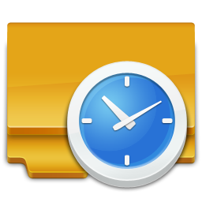
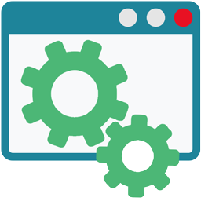

Persistence
Scheduled Tasks
Regsvr.exe registers a .dll file as a command component in the registry.
Emotet as a Windows Service
Registry Run Keys
“Startup type” can be set to “automatic” so that it starts up each time the system is booted, similar to registry run keys or the startup folder.
Ensures the malware persists across reboots

Slide 61
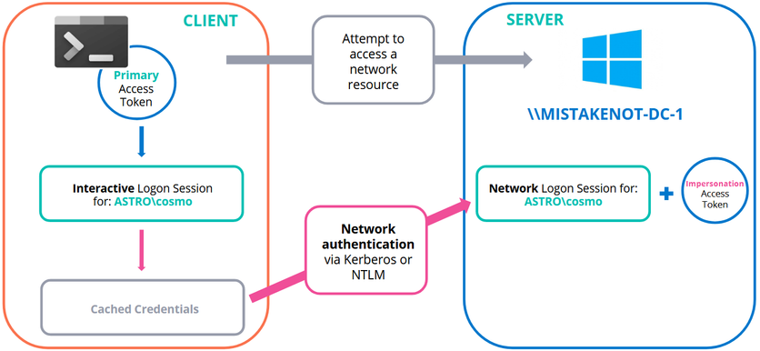
Privilege Escalation
Token Impersonation
Emotet utilizes a variant of Google’s profobuf system (short for protocol buffers) to send messages to servers. Specifically, it uses deliverable messages to communicate with a server to execute code. It sometimes does this by duplicating a user’s token; specifically, a user who has higher privileges than those which Emotet is executing with.
Common Tools
Emotet often makes use of common tools, such as Mimikatz, to aid in basic functions.
Emotet uses Mimikatz for credential theft (NTLM hash compromise) to acquire higher level accesses.

Slide 62


Defense Evasion
Command Obfuscation
Payload Embedding
Emotet will sometimes embed its entire code into other files in order to avoid detection.
Emotet will often embed commands and variable values into other files.

Slide 63

PREVENTION STRATEGY AND TRAINING
Think Before You Click!

Slide 64
Agenda
01
Malware prevention strategy
02
User awareness training

Slide 65
Prevention Strategy

Slide 66


Exercise Caution with Emails
Be Alert to Phishing:
Look out for misspellings, generic greetings, and suspicious attachments or links.
Don’t click on anything unless you’re certain about its safety.
Hover for Safety:
Hover over links to preview URLs before clicking.
Verify sender’s details and other contextual clues.

Slide 67


Be Careful with Downloads
Watch File Extensions:
Avoid suspicious file types like .exe, .bat, or unknown formats.
Always check the source before downloading anything.
Look for Reliable Sources:
Download software only from official websites or reputable sources.
Avoid third-party platforms and be cautious even with Google Ads.

Slide 68



Use Caution with Ads and Websites
Utilize Ad Blockers:
Use ad-blocking software to reduce exposure to malicious ads.
Avoid Clickbait:
Steer clear of sensationalized content designed to deceive and infect with malware.
Share Info Selectively:
Be selective about where you share personal or financial information.

Slide 69



Use Antivirus Software
Activate Real-Time Protection:
Ensure real-time protection is enabled to monitor your system continuously.
Initiate Regular Scans:
Schedule regular full and quick scans to detect and eliminate malware.

Slide 70


Enable Firewall Protection
Control Inbound and Outbound Traffic:
Configure firewall rules to manage traffic, preventing unauthorized access.
Strengthen Admin Security:
Secure firewalls with strong passwords and encryption to protect sensitive information.

Slide 71


Secure Your Network
Strengthen Router Security:
Change default credentials and regularly update your router’s firmware.
Isolate Guest Devices:
Set up a guest network to protect your main network from potential threats.

Slide 72


Keep Software Updated
Stay Updated:
Regularly check for system and software updates to apply critical security patches.
Automate Updates:
Enable automatic updates to ensure timely application of fixes.

Slide 73


Create Strong, Unique Passwords
Craft Complex Passwords:
Use a combination of uppercase, lowercase, numbers, and special characters.
Rotate for Security:
Change passwords regularly, especially for sensitive accounts, to reduce vulnerability.

Slide 74

Implement Multi-Factor Authentication (MFA)
Layered Authentication:
Use 2FA or MFA for additional security layers, like SMS codes or authenticator apps.

Slide 75


Regularly Back Up Your Data
Scheduled Backups:
Back up data on a fixed schedule to minimize data loss risks during attacks.
Encrypt Data:
Enable encryption when using cloud services to protect your data in transit and storage.

Slide 76


Secure Mobile Devices
Restrict App Permissions:
Limit app permissions and uninstall unused apps to enhance mobile security.
Source from Official App Stores:
Download apps only from official stores to avoid malware.

Slide 77


Regularly Monitor Accounts
Vigilant Financial Oversight:
Regularly review bank and credit card statements for unauthorized transactions.
Activate Account Alerts:
Set up alerts for unusual account activities for early detection of fraud.

Slide 78


Disable Unnecessary Processes
Minimize Attack Paths:
Disable or uninstall unused services and processes to limit potential vulnerabilities.
Use Non-Admin Accounts:
Use a user account for daily tasks to reduce potential damage from malware.

Slide 79

Conduct Regular Security Audits
Proactive Vulnerability Scanning:
Perform regular vulnerability assessments and prioritize critical fixes.

Slide 80


Stay Informed and Educate Others
Stay Updated:
Stay informed about the latest cybersecurity threats and best practices.
Encourage Reporting:
Foster a culture of reporting suspicious activities to mitigate risks early.

Slide 81


Vigilance is Key
Cybersecurity demands continuous effort, but the payoff is protection from costly and damaging cyber attacks.
Strong malware prevention practices ensure the safety of your data and maintain trust with customers or stakeholders.

Slide 82
User Awareness Training

Slide 83

User Awareness Training
Cybersecurity is no longer a niche concern for IT professionals alone; it affects everyone.
The Goal of this User Awareness Training is to empower Users with the knowledge to recognize and respond to cybersecurity threats.

Slide 84

What is Cybersecurity?
refers to the technologies, processes, and practices that are designed to protect data from attack, damage, or unauthorized access.

Slide 85



Recognizing Cybersecurity Threats
Phishing
Malware
Social Engineering

Slide 86




Phishing
Phishing is one of the most prevalent forms of cyberattacks, and it typically involves emails, text messages, or phone calls designed to trick you into revealing sensitive information.
How to Identify a Phishing Email?
Urgency
URLs
Attachments

Slide 87




Malware
Malware refers to any software intentionally designed to cause damage to a computer, server, client, or network.
Prevention Tips
Think Before You Click!

Slide 88



Social Engineering
Social engineering attacks exploit human psychology rather than technical vulnerabilities. Attackers manipulate individuals into revealing confidential information, often posing as trusted authorities.
Pretexting
Tailgating
Baiting

Slide 89



Password Management

Slide 90




Password Management
Strong Passwords
Use at least 12 characters.
Avoid using obvious personal information
Use a unique password for each account.
Multi-Factor Authentication (MFA)
Use Password Manager

Slide 91




Safe Internet Habits
Safe Browsing
Fake websites can steal your sensitive info.
Signs of Unsafe Websites:
No "https" or broken lock in the address bar.
Pop-ups requesting personal data.
Suspicious download links.

Slide 92


Data Protection and Privacy
Limit what personal information you share on social media.
Use privacy settings on social platforms to control who can see your information.

Slide 93
Incident Reporting and Response

Slide 94



Recognizing Cyber Incidents
Unfamiliar login attempts on accounts.
Missing or altered data.
Notifications from antivirus software about detected threats.

Slide 95



Reporting Procedures
Record details of the suspicious activity (e.g., time, email content, attached files).
Contact your IT support or incident response team.
Follow instructions on what to do next (e.g., disconnect from the network).

Slide 96
Stay Safe
Protect Yourself
Think Before You Click!

Slide 97


SIEM
Configuration and Monitoring

Slide 98



Splunk As SIEM
Splunk is widely used in cybersecurity for its ability to collect, analyze, and visualize vast amounts of data from various sources.
Centralized Log Management
Real-Time Monitoring
Advanced Analytics

Slide 99

Splunk
Splunk has three main components
Forwarder
Indexer
Search Head

Slide 100

Splunk Setup
Ubuntu VM Setup for Splunk
Create a New VM
assign suitable resources for that vm RAM, Memory and hard disk
assign a suitable vlan to the vm and make sure this vlan can reach all vlans to collect logs from

Slide 101

Splunk Installation
downloaded the .tgz package for Splunk Enterprise

Slide 102

Splunk Installation
Admin username and password Setup
Enable Splunk to Start at Boot
To ensure Splunk starts automatically whenever the VM is booted, I ran the following
sudo /opt/splunk/bin/splunk enable boot-start

Slide 103

Splunk Installation

Slide 104

Splunk Installation
Access Splunk, open the browser within the VM and go to the address http://coffely:8000.

Slide 105
Splunk Setup
Access Splunk
In the Splunk dashboard,Forwarding and Receiving
Under “Receive data,“Add new”and set the listening port
Configuring Splunk Universal Forwarder on Windows Server
Downloading and Installing Universal Forwarder to send logs from windows server to splunk
Download the Windows version of the Splunk Universal Forwarder from the Splunk Download page

Slide 106
Splunk Setup
Install the Forwarder
run the .msi installer, accepted the license agreement, and entered the Splunk admin credentials during the setup
configure the Universal Forwarder with the IP address of my Splunk VM (found using ip a) and specified ports 8089 and 9997 for communication

Slide 107

Forwarder Setup

Slide 108

Forwarder Setup

Slide 109
Forwarder Setup
Configuring Data Ingestion
With the Universal Forwarder installed, I set up data ingestion
Add Data Source in Splunk
In Splunk, go to Settings > Add Data and selected “Forward.”
Add server VM as a data source and configured it to send all local event logs to Splunk
Create a new index named “Windows” to store the logs

Slide 110

Forwarder Setup
Verify Data Ingestion
In Splunk, I navigated to Apps > Search & Reporting and ran a search query
index= "windows"

Slide 111

Monitoring

Slide 112
Conclusion
Cyber security is crucial in protecting personal, financial, and system integrity in an increasingly connected digital world. Threats like malware, phishing, and ransomware can cause significant damage if not properly addressed.

Slide 113

THANK YOU!

